Slide 1
Improving R Code Performance
By Ehsan Jahanpour
Data Scientist @ Bayer Crop Science

Slide 2
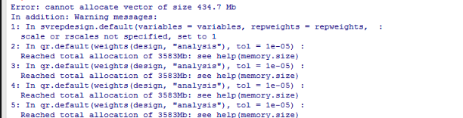
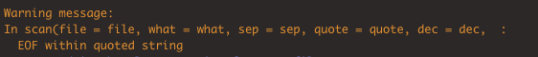

Slide 3


Slide 4
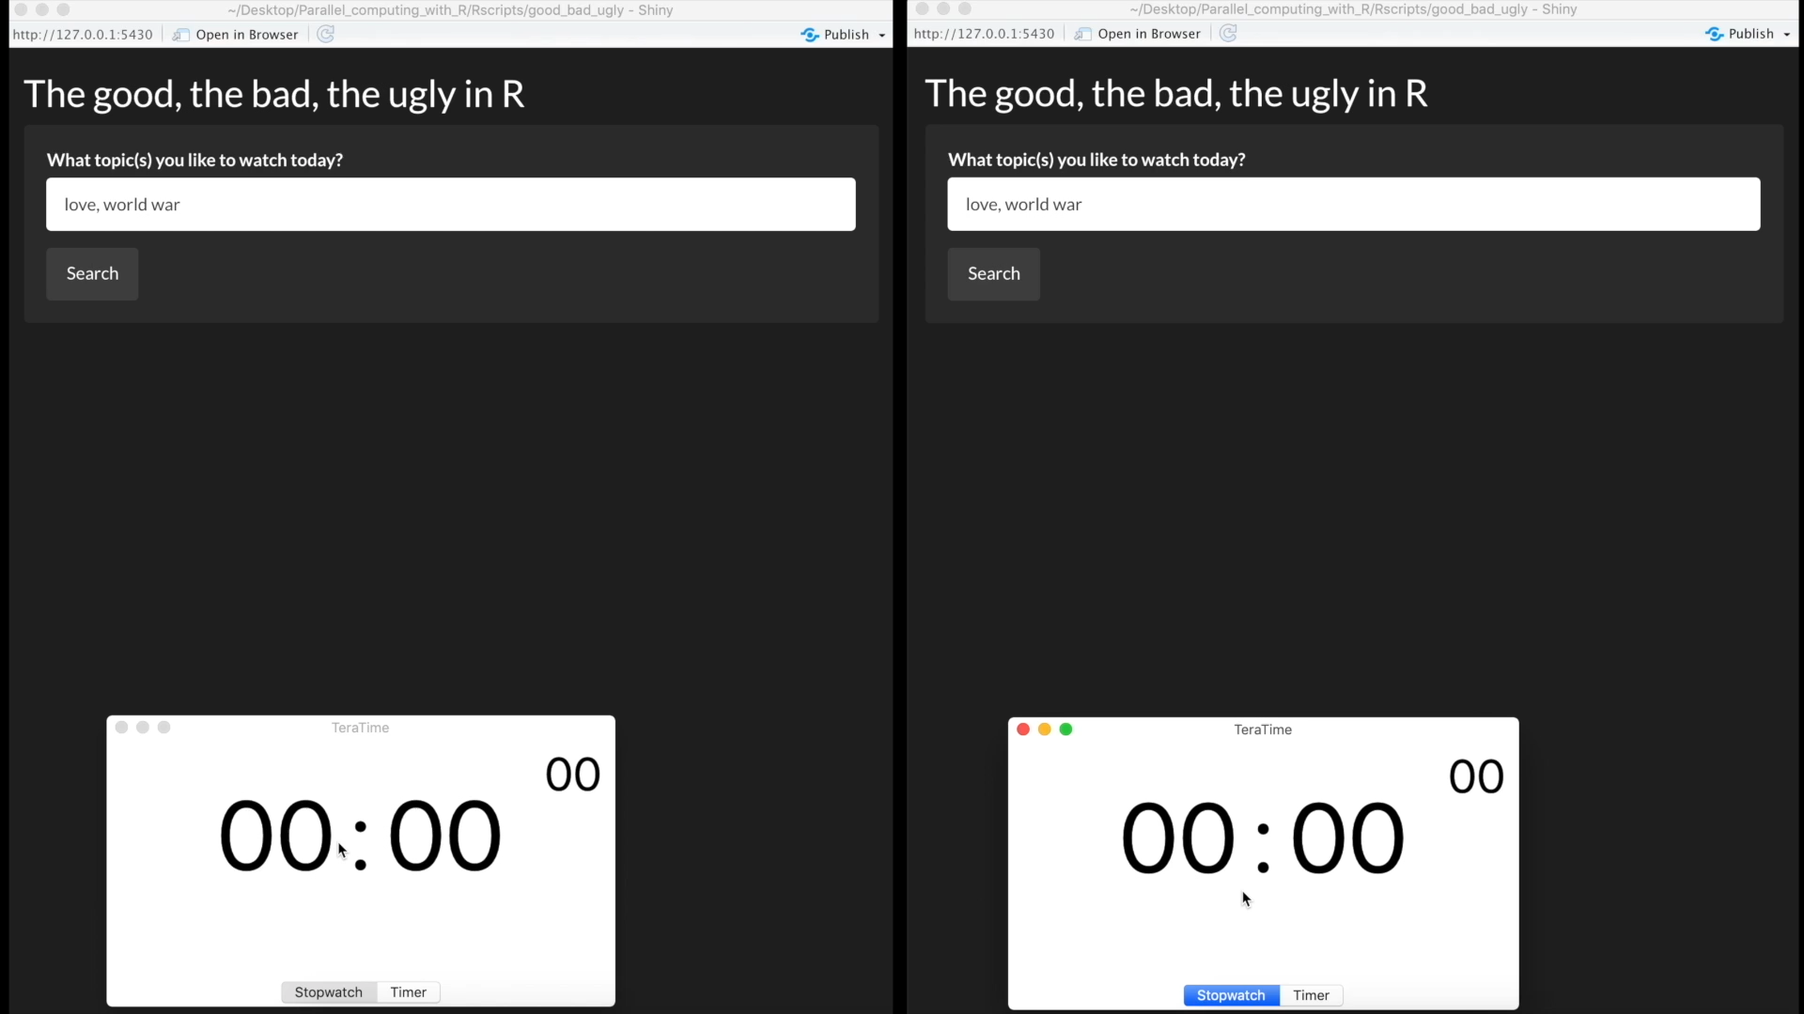

Slide 5
Glossary
Primitive functions: C code compiled into R at build time
“{, (, [, [[, if, for, …, is.na, is.numeric, …, length, class, … list“
primitive replacement functions don’t have to make copies

Slide 6
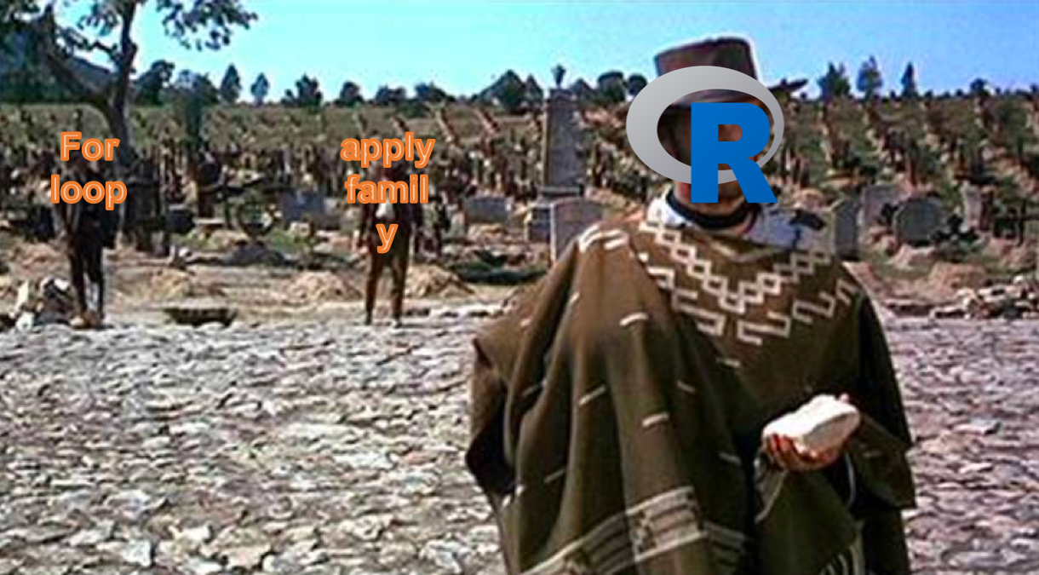
Let’s start from Ugly

Slide 7
Additional Resources
Movie Search Repo: https://github.com/ejahanpour/MovieSearchShiny
3 Implementation details: https://medium.com/@jahanpour.ehsan/the-good-the-bad-the-ugly-in-r-72e55b2219cc
Profiling Blog: https://medium.com/@jahanpour.ehsan/you-need-regular-check-ups-so-do-your-codes-ed7e6f3de01b
Profiling YouTube: https://www.youtube.com/watch?v=tqrveDnoJsc

